Slide 1
School Uniform

Slide 2
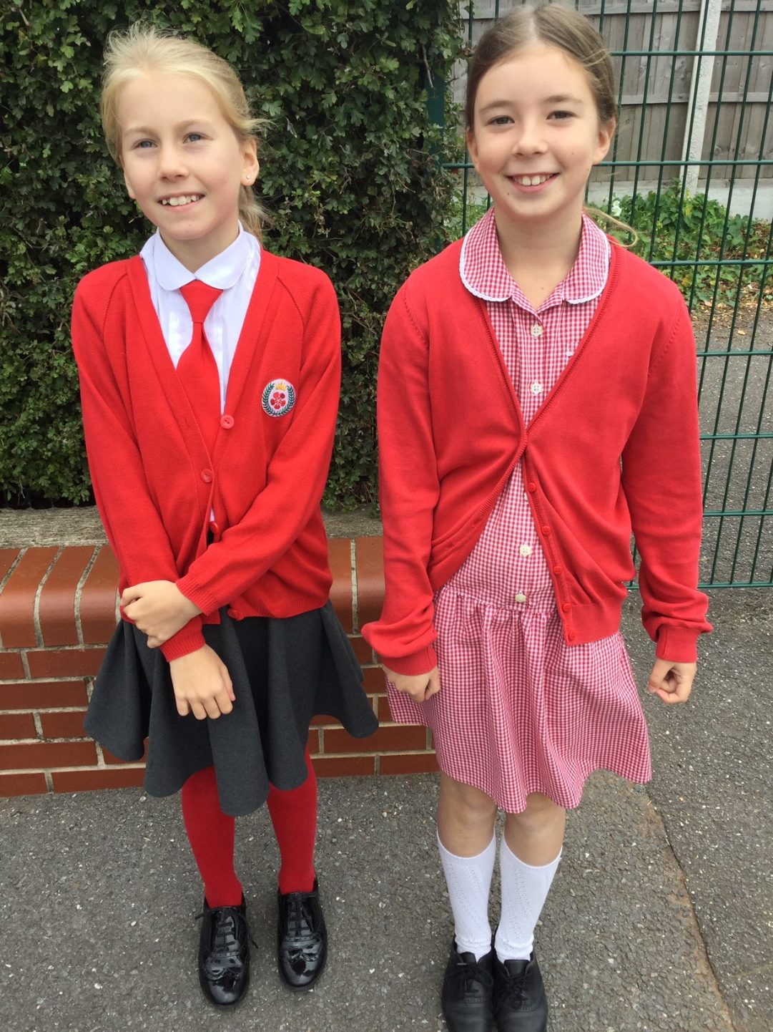
Girls Uniform
Grey skirt/pinafore/culottes
White shirt
Red tie
Red cardigan
White socks/red tights
Summer uniform – Easter to October half-term.
Gingham dress (red and white)
Red cardigan
Grey/red fleeces can be worn outside but not as an alternative to a school cardigan.

Slide 3
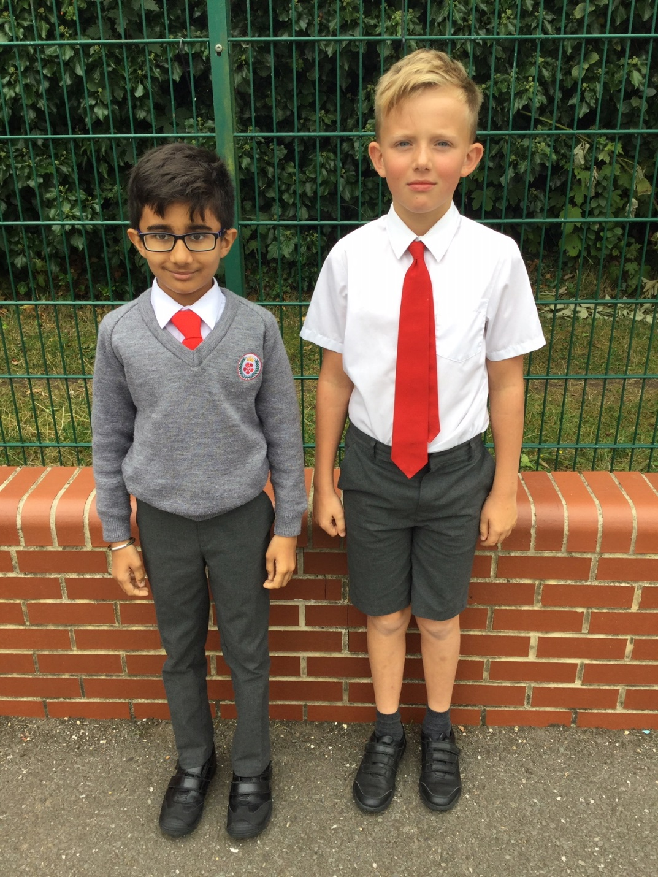
Boys Uniform
Grey trousers
White shirt
Red tie
Grey v-neck jumper
Grey socks
Grey shorts can be worn from Easter to October half-term.
Grey/red fleeces can be worn outside but not as an alternative to a school jumper.

Slide 4
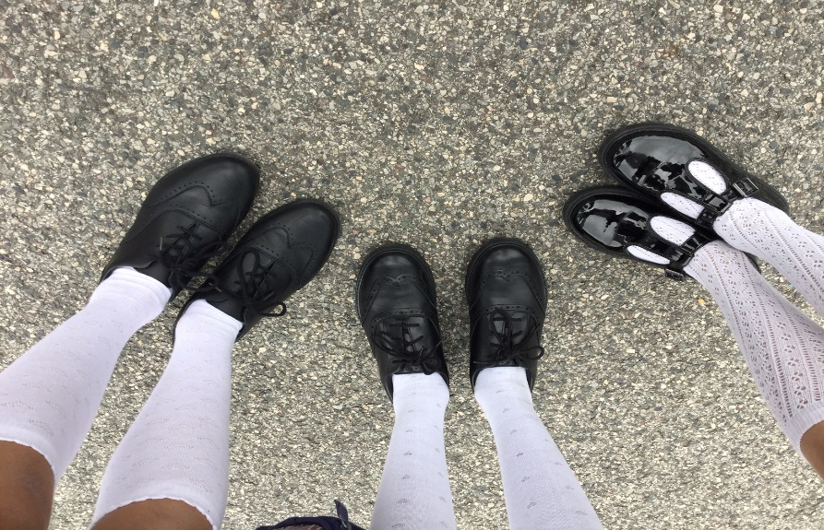
Shoes
Black leather/leather-look shoes
No canvas/trainer type shoes or boots

Slide 5
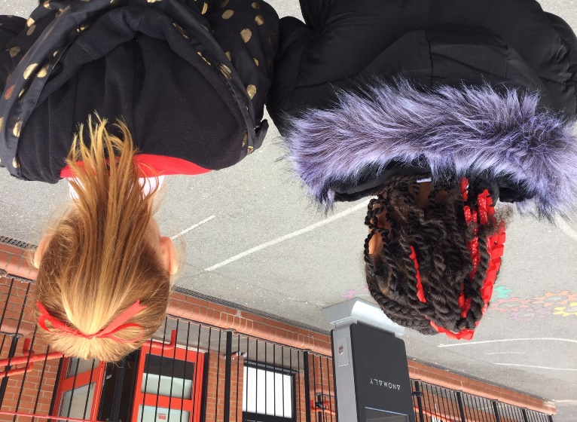
Hair Styles
Long hair should be tied back
Hair accessories should be in school colours. No large bows
Hair should be blended - no shaved hairstyles/tramlines
Floppy fringes must be clipped/tied back
No dyed/highlighted hair

Slide 6
PE Kit
Red or white T-shirt & shorts
Trainers/plimsolls (not suitable for outdoors)
Red or grey jogging bottoms/sweatshirt
Year 5 – Red/white team kit
Bring your named kit to school in a drawstring bag

