Slide 1

Welcome to Year 1
Together Everyone Achieves More

Slide 2
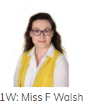
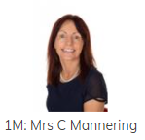
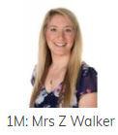
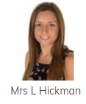

The Team
Class Teachers
Mrs Mannering (Mon/Tues/Weds) 1M
Mrs Walker (Thurs/Friday) 1M
Miss Walsh 1W
Teaching Assistants
Mrs Pezzolo
Mrs Hickman
Additional Staff
Madame Wilks (French)
Mr Haywood (P.E.)

Slide 3
Transition……..
What does a day in Year 1
look like?
What do we expect?

Slide 4
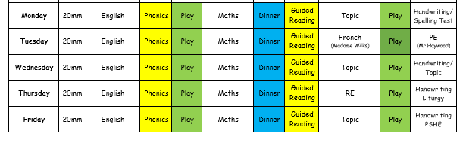
Year 1 - Weekly Timetable

Slide 5

English Expectations
The English expectations for the end of Year 1 are;
Write clearly demarcated sentences
Use the conjunction and to join sentences
Introduce use of – capital letters, full stops, question marks, exclamation marks
Use capital letters for names and personal pronoun “I”
Write a sequence of sentences to form a short narrative
Use correct formation of upper and lower case letters
These concepts are taught to the children many times throughout the year and revisited regularly to allow children to develop their understanding and secure these skills independently.

Slide 6
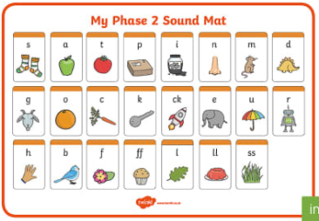
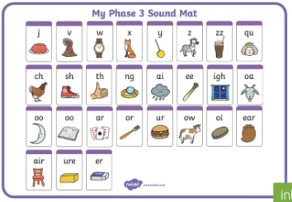
Phonics
Phase 2 – 44 sounds – examples - ll, ss, ff
Phase 3 – 25 sounds – examples - ch/ar/ow/ai

Slide 7
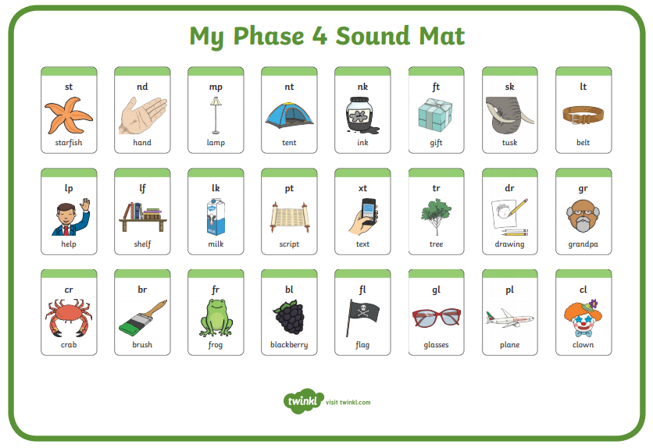
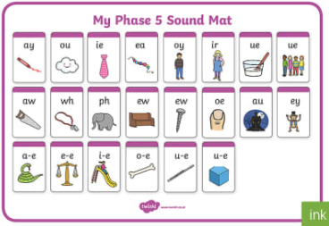
Phase 4 – during this stage children consolidate and refine their knowledge and learn new tricky spelling patterns CVCC and CCVC
Phase 5 – alternative spelling for sounds – “ai, ay, a, a-e, eigh, ey ” . They also learn about split diagraphs. (a-e)
Phonics Screening – Monday 7th June 2022

Slide 8

Maths Expectations
The Maths expectations for the end of Year 1 are;
Count to and across 100 forwards and backwards
Read and write numbers to 20 in words
Say 1 more/1 less to 100
Count in multiples of 2, 5 and 10
Use bonds and subtraction facts to 20
Solve one step multiplication and division
Recognise half and a quarter of an object, shape or quantity
Use language of time – eg day, week, month, year
Tell the time to hour and half past
ICT Topmarks
We will teach these skills multiple times throughout the year within our class teaching and learning. To support our teaching there may also be consolidation tasks linked to them sent out for homework.

Slide 9
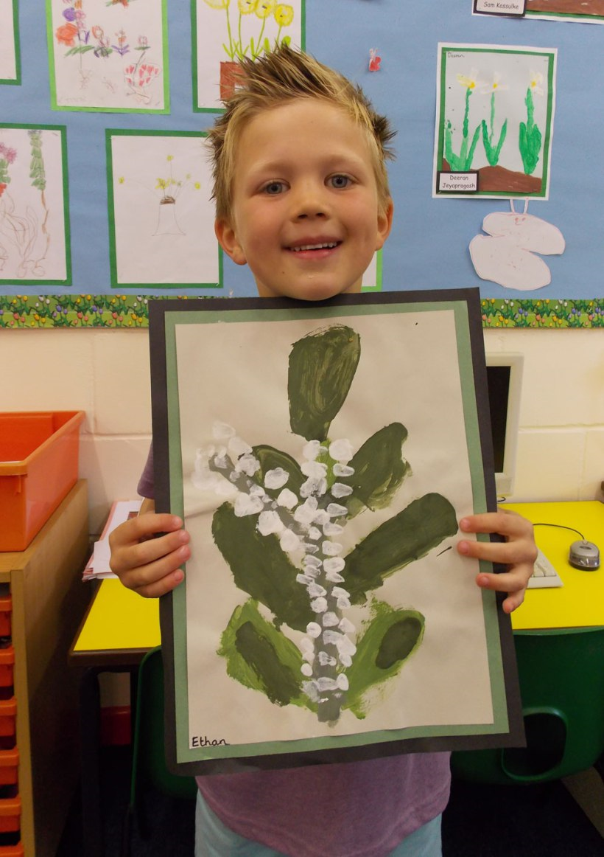
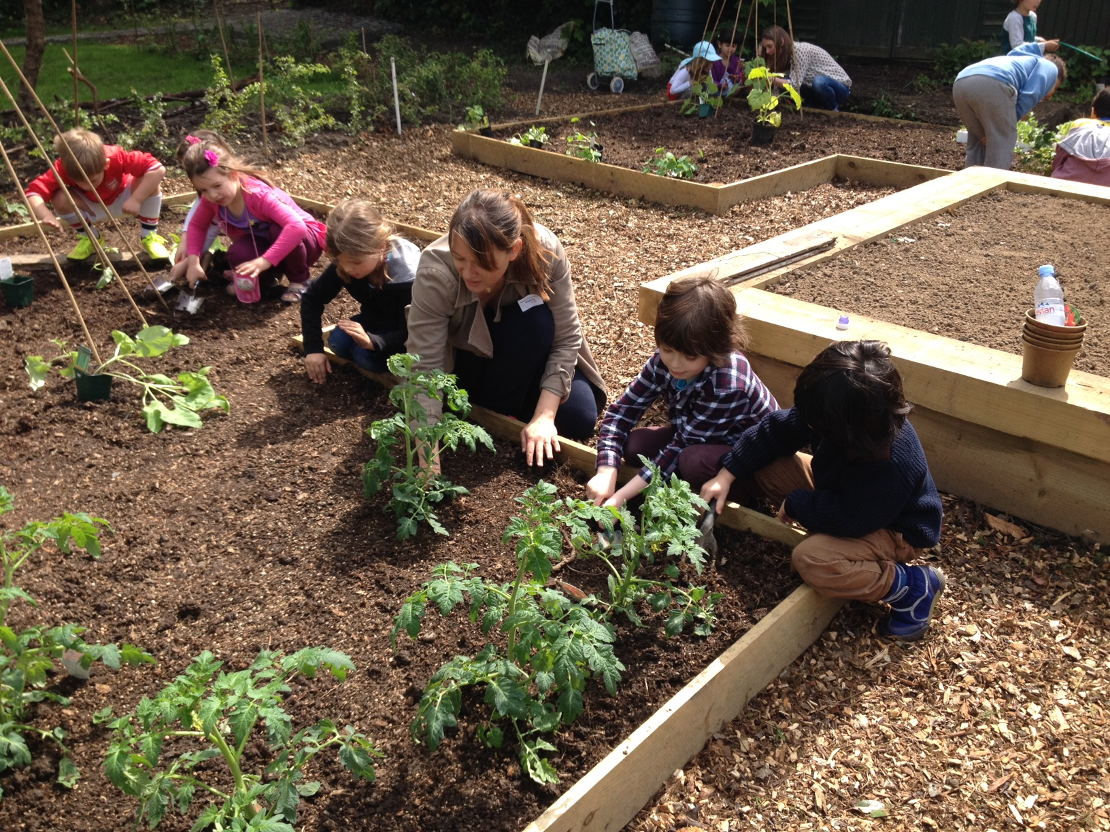
Afternoons
Art
Science
DT
RE
Geography
History
Music
Drama
Handwriting
PSHE
Allotment Time

Slide 10
Seesaw
Seesaw is a means for us to maintain a home school support and communication system with yourselves.
If you would like to contact us please feel free to send us a message via Seesaw.
Your child will have been given a Seesaw QR code in order to access their class Seesaw journal. Many of you will be familiar with this after its use during lockdown. If you are new to this system or you need any further support, please follow this link to help you navigate your way around. https://youtu.be/F04ws8cFuq8

Slide 11
Homework
Spelling Tests will take place in school every Monday. We will notify you of their results. The new spellings and homework for the week will be given out each Tuesday.
Children are encouraged to read their reading books daily with an adult if possible.
Encourage your children to sound out words when you are out and about e.g. road signs, labels, advertisements etc
Encourage your child to try and write one or two simple sentences about their weekend/a hobby or activity they do outside school.

Slide 12
Other key points
At the end of the day we will dismiss the children from the right hand side of the playground. We would really appreciate it if you could stand near this area to make the end of the day a smooth transition.
Your child will be given a day for which they will read with a teacher in a guided session and change their books for the week. We will notify you through Seesaw which day they have been allocated.
Children are encouraged to bring a bottle of plain water in a labelled bottle as they will have access to this all day. Please do not send fruit juice, squash or flavoured water.
Please make sure your child’s uniform and PE kit are clearly labelled with forename and surname. PE will take place on a Tuesday.

Slide 13
Other key points
Fruit is provided but if you wish to send your own in a small labelled tub please feel free to do so.
Every child over the age of 5 is entitled to milk at a subsidised price of around £14 per term. If you wish your child to have milk please register online at www.coolmilk.com
Whilst all Key Stage 1 children receive a free school meal, your child may be eligible to receive additional financial support in school to access school trips, pay for uniform, take part in extra curricular activities etc. If you feel your child could benefit from this additional funding please visit the following website to check against the criteria. If you are eligible against the free school meal criteria listed through this link, you may also be entitled to this Pupil Premium funding.
https://www.gov.uk/apply-free-school-meals

Slide 14



Questions
If you have any further questions about anything you have read or anything you are not sure about, please do not hesitate to contact us. Please contact us via seesaw and we will respond to your questions as quickly as possible.

