Slide 1
Welcome to Year two!

Slide 2
Introduction
Our aims:
To introduce you to the year 2 team
To provide you with an outline of the year two curriculum
Inform you of the end of key stage assessments
Offer guidance for supporting your child at home

Slide 3
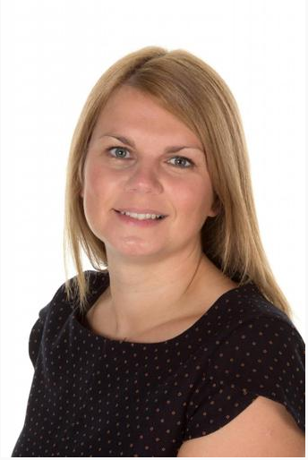
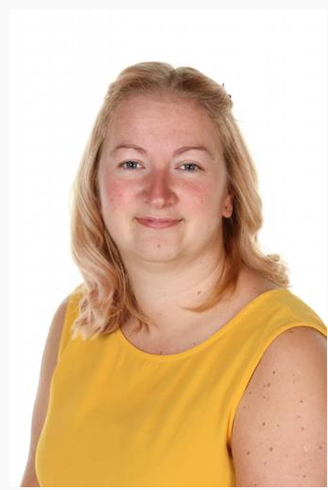
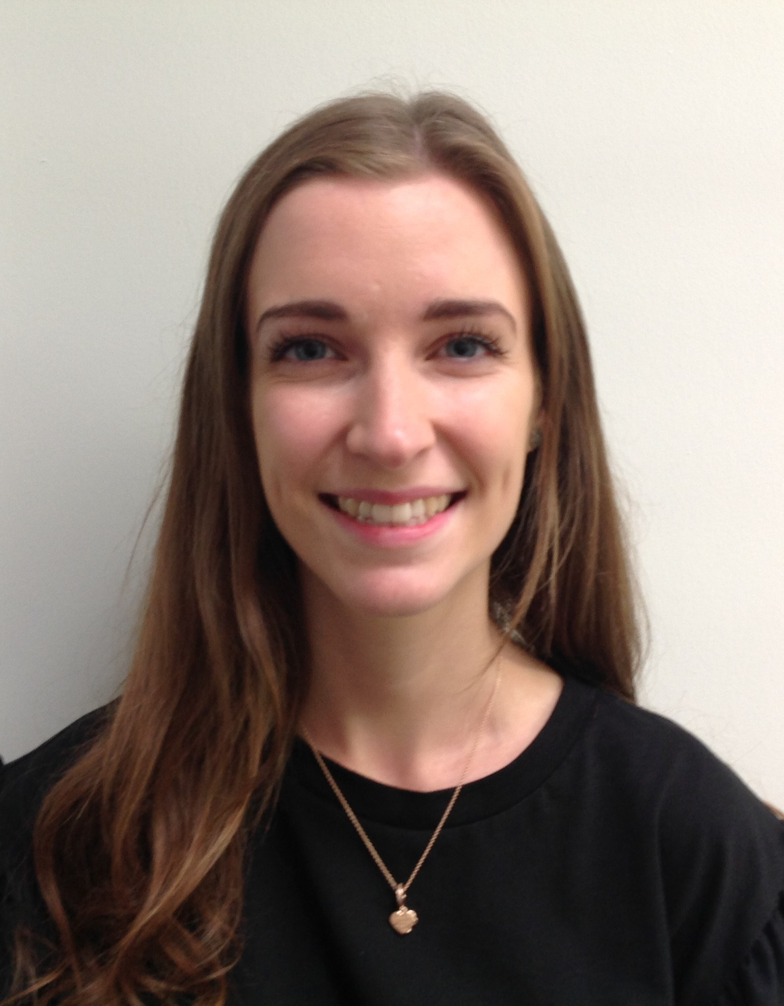
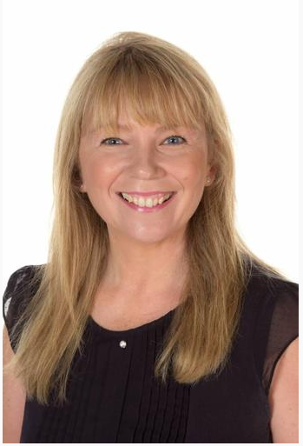
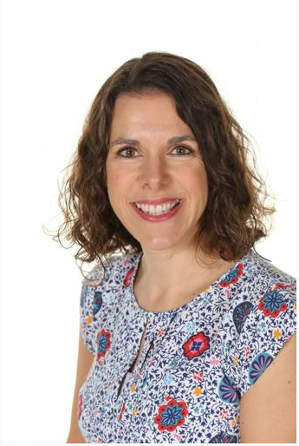
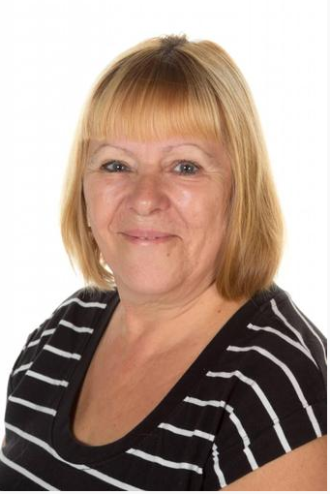
The year 2 team
2W
Mrs Woolley
(Monday/Tuesday)
2W
Mrs Bilbie
(Wednesday/Thursday/Friday)
2F
Miss Frampton
Mrs Doran
(Monday/Tuesday/
alternate Fridays)
Mrs Guttridge
(Wednesday/Thursday/
alternate Fridays)
Miss Nicholson

Slide 4
Polite reminder
Please speak to the office if:
Your child is not going to be in school because they are unwell or any other reason
Your child has a medical appointment
the collection arrangements for your child are going to change
Teaching staff will check messages on seesaw but will be unable to do this when teaching so may not see any urgent messages.

Slide 5
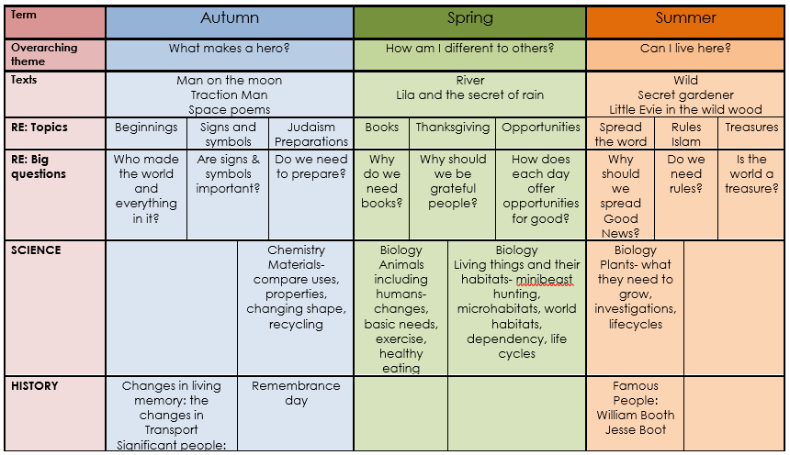
Yearly overview

Slide 6
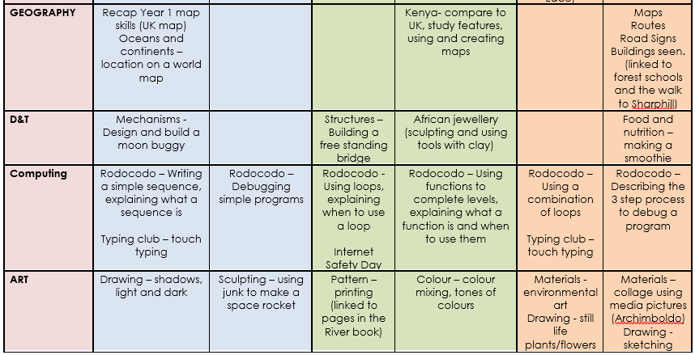

Slide 7
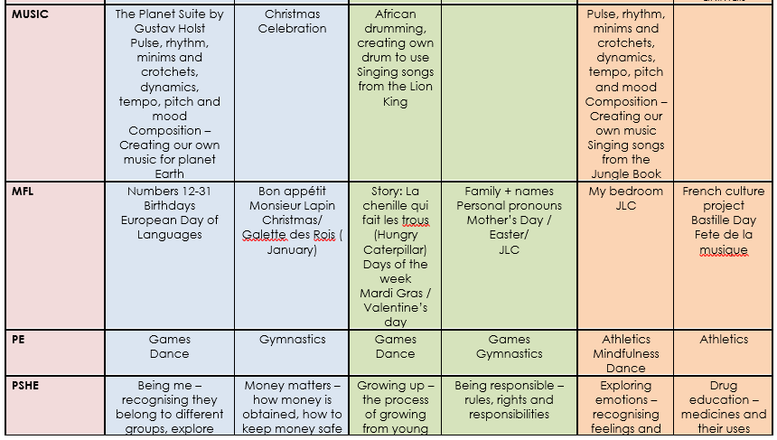

Slide 8
Writing in year 2
The main areas of focus in English are:
using the four sentence types (statement, exclamation, question, command)
the correct punctuation
conjunctions (joining words)
contractions (I’m, it’s)
possessive nouns (the dog’s, the child’s)
adjectives and adverbs for detail

Slide 9
Supporting your child with reading
Reading is extremely important.
Reading little but often is better for your child rather than reading an entire book in one go.
We send home two books each week and we would expect that your child reads them at least twice.
Stay positive
Discuss the book
Encourage expression
Look out for interesting vocabulary

Slide 10
Supporting your child with writing
Encourage opportunities for children to write: letters to family or friends, shopping lists, stories or poems, notes or reminders.
Let them have a go first.
Get them to expand by adding adjectives or telling us where or when something takes place. See if they can use conjunctions or ask them to use some interesting vocabulary they found in their reading book.
Then go back and look at them together- is there any basic punctuation missing? Are there any Year One and Year Two common misconception words that they should be spelling accurately written incorrectly?

Slide 11
Supporting your child with maths
During key stage one, there is a big focus on basic number skills. This means securing a good understanding of place value and recognising and using number bonds to 20, including being able to quickly recall the total of any two numbers up to 20.
Encourage them to:
tell the time,
count in 2s, 3s, 5s and 10s forwards and backwards
count out your money or change in the shop,
look for shapes in and out of the house,
identify, weigh and measure quantities in the kitchen

Slide 12
homework
New homework will be given out on a Monday.
Each week the children will have new spellings to learn (linked to our phonics). We will be sending home a sheet to help the children practice at home. These need to be returned to school the following Monday.
Spelling tests will take place on a Monday.
After guided reading in school the children will bring home two reading books. We will post a picture on Seesaw of the book the group has read in school.
Each half term there will be a small project for the children to complete and return to school during the last week of the half term. Details about this will be posted to Seesaw.
We will also be using Myon and setting projects throughout the year.

Slide 13
assessment
During the Autumn Term the children will complete a phonics screening check. The children will be asked to read 40 words, 20 will be real phonetically decodable words and 20 will be alien words (made up words that are phonetically decodable)
In school We already use a variety of testing and assessment methods to track progress and the children will become familiar with these.
They will see testing as part of their normal classroom routine.
We do not mention the word SATs to the children in the Summer term but simply tell them that their work will be done in a special booklet instead.
We will not even tell you that the SATs are being done.
Children will undertake tests in Reading, Maths and Grammar, Spelling and Punctuation.
All results are looked at and used to inform decisions- they are not the be all and end all! The results given at the end of the year are based on teacher assessment that has taken place all year round.

