Slide 1

Welcome to Year 3
Together Everyone Achieves More

Slide 2
The Team
Class Teachers
Mr Brown 3B
Miss Ciach 3C
Teaching Assistants
Mrs Parker, Mrs Coffey, Miss Jones
PPA support
Madame Wilks (French)
Mr Haywood (P.E.)

Slide 3
From Key Stage 1
To
Key Stage 2
What do we expect?
What does a day in Year 3
look like?

Slide 4
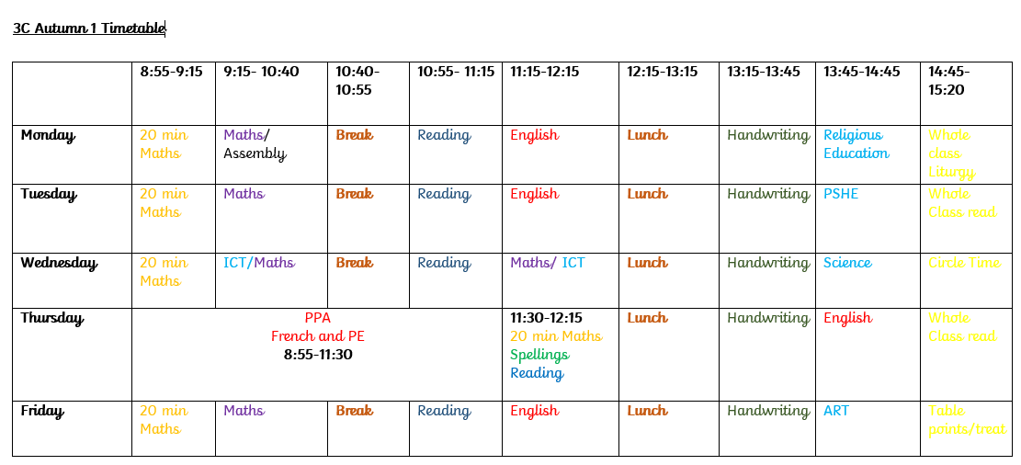
Year 3 Weekly Timetable
Timetable is subject to change due to liturgies and other school activities.
Forest schools will take place in Summer 1.

Slide 5

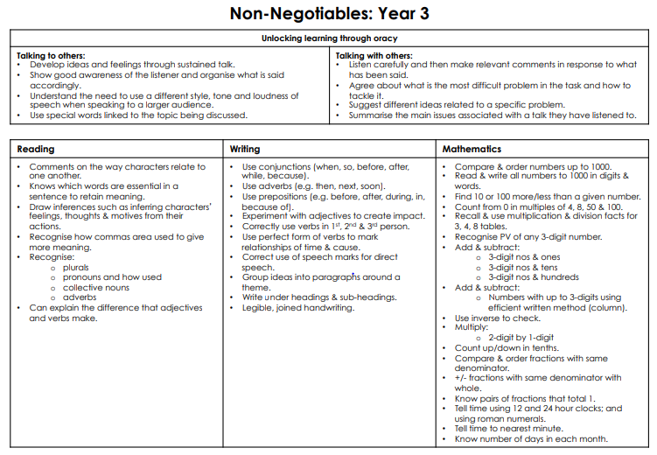
Non-Negotiables

Slide 6
Homework
Homework will be given out every Thursday. This needs to be returned the following Wednesday. It will consist of spellings, Numeracy, Reading and sometimes English, Topic or RE.
Children are encouraged to read for 20 minutes each day. This can be a combination of silent reading and reading with an adult.
MyOn reading project will be set each week. (Logins to Myon and various platforms will be provided this week)
Websites such as spelling shed, TT rockstars, may be used as a part of homework activities.

Slide 7
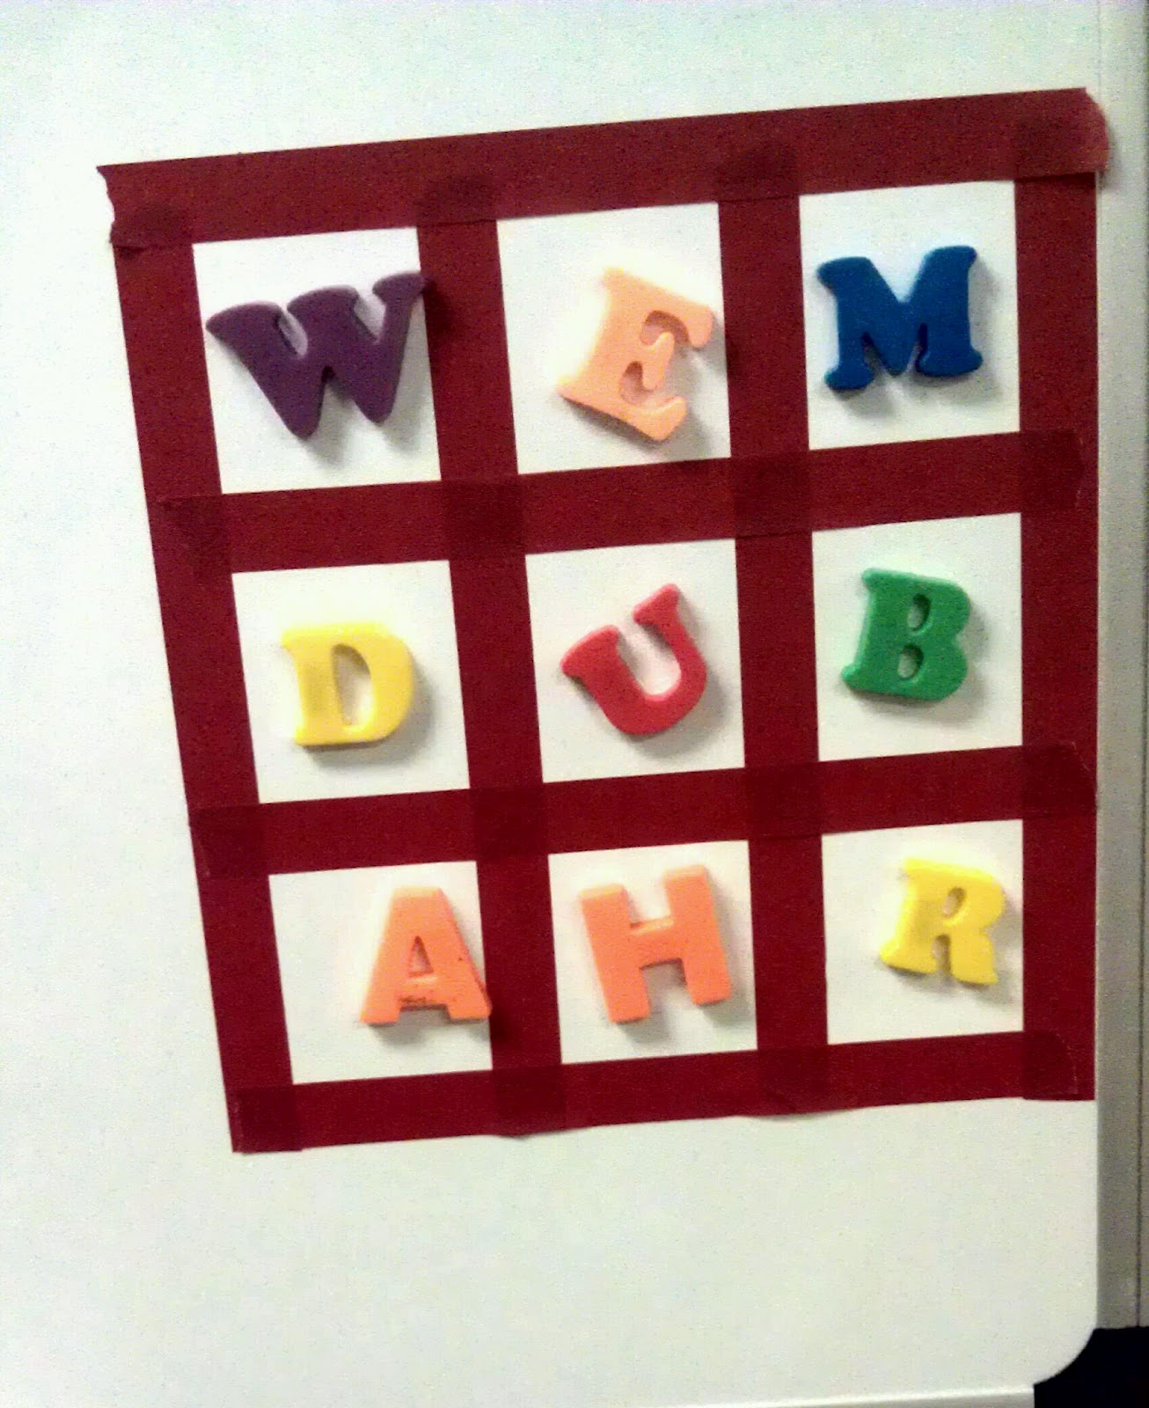
How to help your child.
Encourage your child to use the correct grammar when speaking as this transfers to their writing.
Read anything! Leaflets, posters, television guide, road signs! If children are not sure what a word means, encourage them to use a dictionary to look up the meaning and apply it to the context of the sentence.
Practise times tables with them. Play games, make mistakes for them to spot and correct you.
Encourage your child to ‘teach you’.
Have fun with your child!

Slide 8
Other key points
Accelerated quiz – Children will have the opportunity to quiz on the IPad every day when they have finished reading a book.
Read 10 books a half –term (6 will be covered by the MYon project).
Ensure uniform and PE kit are labelled – All children require a t- shirt and shorts / jogging bottoms for outside and plain t-shirt and shorts for indoor PE. Children to come into school wearing uniform and change into PE kit at school.
If there is a change in collection arrangements please write a letter or telephone the office.
Seesaw – Communications will be sent through Seesaw and ParentMail. Please ensure you sign up to your child’s Seesaw journal.

Slide 9



Questions
If you have any questions, please do not hesitate to contact us via See Saw.

