Slide 1

Welcome to Year 4
First Attempt In Learning
Building Resilience

Slide 2
The Team
Class Teachers
Miss Dawson 4D
Miss Richmond 4R
Teaching Assistants
Miss Martin
Mrs Barrett

Slide 3
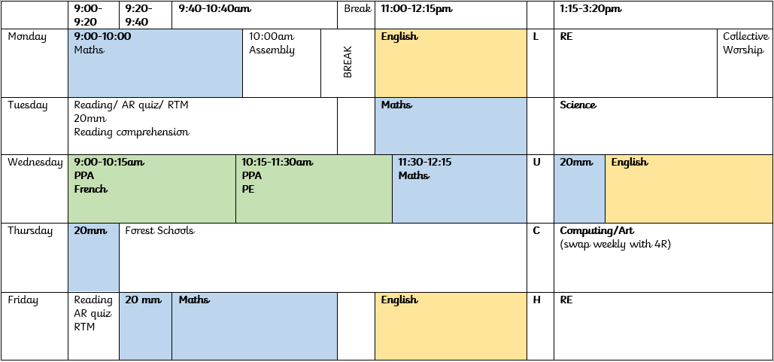
4D Autumn 1

Slide 4
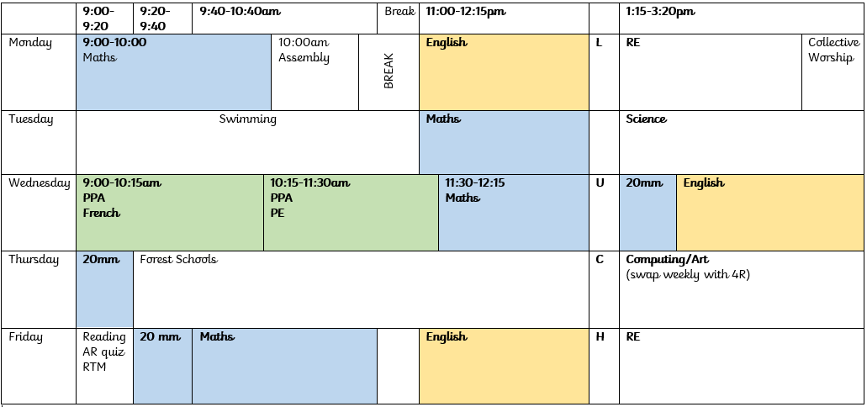
4R Autumn 1

Slide 5

Maths Non Negotiables
Count backwards through zero to include negative numbers.
Compare and order numbers beyond 1,000.
Compare and order numbers with up to 2 decimal places.
Read Roman numerals to 100.
Find 1,000 more/less than a given number.
Count in multiples of 6, 7, 9, 25 and 1000.
Recall and use multiplication and division facts all tables to 12x12.
Recognise PV of any 4-digit number.
Round any number to the nearest 10, 100 or 1,000.
Round decimals with 1dp to nearest whole
Add and subtract:
  Numbers with up to 4-digits
Multiply and divide:
  2-digit by 1-digit
  3-digit by 1-digit
Count up/down in hundredths.
Recognise and write equivalent fractions
Add and subtract fractions with same denominator.
Read, write and convert time between analogue and digital 12 and 24 hour clocks.

Slide 6

Reading Non Negotiables
Give a personal point of view on a text.
Re-explain a text with confidence.
Justify inferences with evidence, predicting what might happen from details stated or implied.
Use appropriate voices for characters within a story.
Recognise apostrophe of possession (plural)
Identify how sentence type can be changed by altering word order, tenses, adding/deleting words or amending punctuation.
Explain why a writer has used different sentence types or a particular word order and the effect it has created.
Skim & scan to locate information and/or answer a question.

Slide 7
Writing Non Negotiables
Vary sentence structure, using different openers.
Use adjectival phrases (e.g. biting cold wind).
Use appropriate choice of noun or pronoun.
Use fronted adverbials.
Use apostrophe for plural possession.
Use a comma after fronted adverbial (e.g. Later that day, I heard bad news.).
Use commas to mark clauses.
Use inverted commas and other punctuation to punctuate direct speech.
Use paragraphs to organised ideas around a theme.
Write with increasing legibility, consistency and fluency.

Slide 8
How to help your child
Encourage your child to use the correct grammar when speaking
Use reading books and other literature to find uses of language and sentence structure
Encourage your child to ‘teach you’
Practise those times tables
Read with your child
Have fun with your child!

Slide 9
Homework- Set on SeeSaw
Maths will be set each week to consolidate learning
Battles will be set on TTRockstars but children can practise at any time
Spellings will be given out at the beginning of every half term for that term. They are tested every Monday.
  Spelling shed will now be used to set challenges and games for the children to practise their weekly spellings
Reading will be set using myON. There will be one book a week.
English homework will be given out to consolidate learning.
RE homework will be given out every 4 weeks.

Slide 10
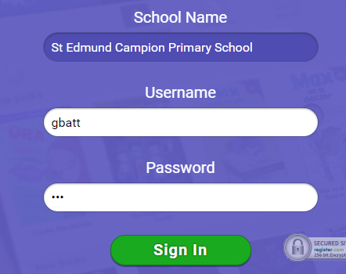
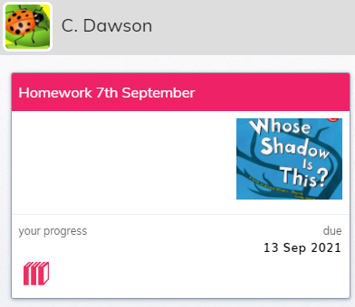
myON
It is the same as accelerated reader
Username: first letter of the first name, first 4 letters of the surname
Password: ABC
Go to projects
The project name is the start date
Below is the due date

Slide 11
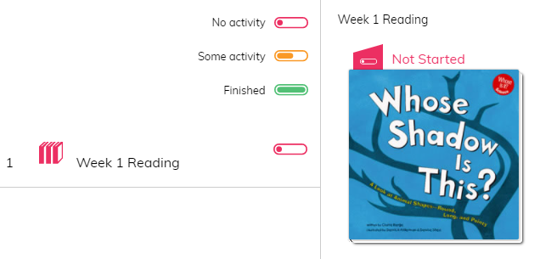
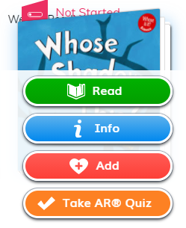
Choosing the project will bring you to this page
Hover over the book to see the options. You can:
Read the book
Look at the information which includes an overview
Add it to your favourites
Take the linked Accelerated Reader wuiz

Slide 12
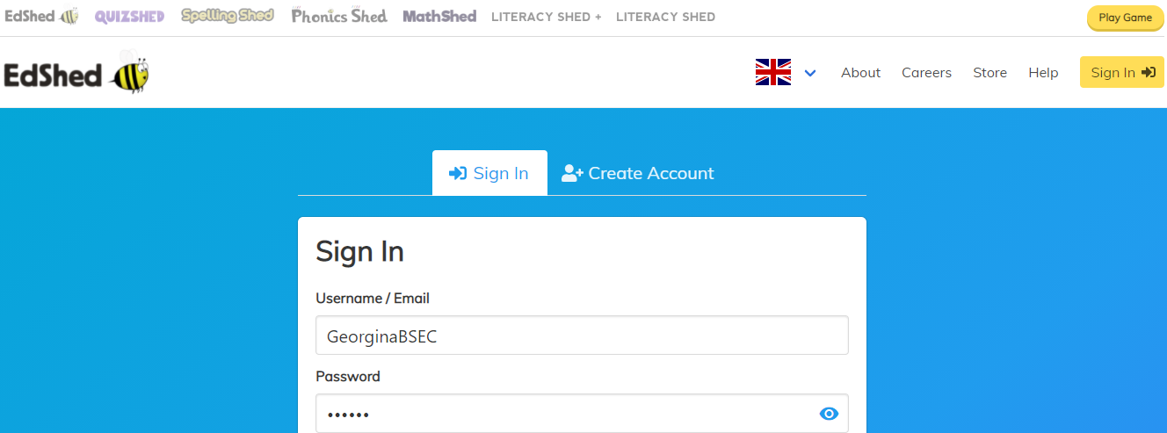
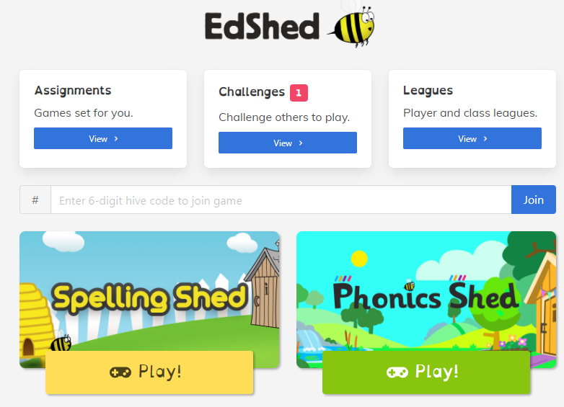
Spelling shed
Username: first name, first letter of surname capitalised, SEC
Password: 000000
The challenges set are the Spelling homework.
Each relate to the weekly spelling and help the children to learn them

Slide 13
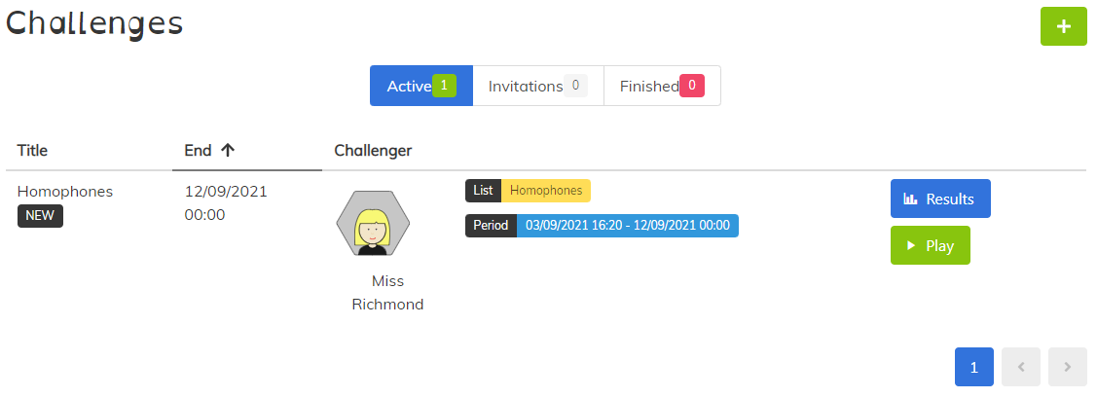
Spelling homework
Duration of the practice
Spelling rule for the week

Slide 14
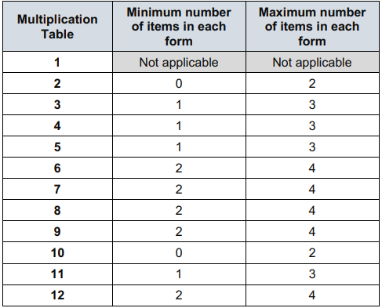
Times Tables Test
Very similar to TTRockstars
Questions up to 12 x 12
Check that the benchmark is being met before moving to Upper Key Stage 2- DfE- no pass mark has been set
June- three week window
25 questions, 6 seconds, 3 second gap

Slide 15
PGL
PGL has been booked for 11th-13th of May.
Wide variety of activities
Team work
Relationship building
Helps to build on Forest School sessions
Develops independence and levels of responsibility

Slide 16
Other key points
Uniform and PE kit labelled.
Pencil cases and personal belongings.
Water bottles
Accelerated reader- 10 books per half term

Slide 17

Any questions

